Slide 1
A+ Computer Science
PICTURE LAB

Slide 2
Matrices
A matrix is an array of arrays.
int[][] mat = new int[3][3];
mat[0][1]=2;
0 1 2
0 1
2
0 | 2 | 0
Which array?
0 | 0 | 0
Which spot?
0 | 0 | 0
Notes:
Each spot in an matrix stores the location/address of an array.
mat[0] stores the location / address of a one-dimensional array.
mat[0][1]=2;
This line sets mat[0] spot 1 to 2.

Slide 3
Matrices
Searching for a specific value
Summing up all or some
section of the matrix
Rotating all of the values
Reversing all of the values

Slide 4
Matrices
int[][] mat = {{5,7},{5,3,4,6},{0,8,9}};
int sum = 0;
for( int[] row : mat )
{
for( int num : row )
{
sum += num;
}
}
System.out.println( sum );
OUTPUT 47
Notes:
Summing up a matrix involves visiting each value going row by row and adding each value to a variable.

Slide 5
matrixsum.java

Slide 6
Matrices
int[][] mat = {{5,7},{5,3,4,6},{0,8,9}};
int count = 0;
for( int[] row : mat )
{
for( int num : row )
{
if( num == 5 )
count++;
}
}
System.out.println("5 count = " + count);
OUTPUT 5 count = 2
Notes:
Searching for values in an array or matrix is a common process often tested on the AP exam.

Slide 7
matrixsearch.java

Slide 8
Matrix of References

Slide 9

public class Dog
{
private int age;
private String name;
public Dog( String n, int a ) {
age = a;
name = n;
}
public int getAge() {
return age;
}
public String getName() {
return name;
}
public String toString() {
return "Dog - " + name + " " + age;
}
}
Dog Class
Notes:
Classes are used to store related methods and variables.

Slide 10
Matrix of Dog
OUTPUT null fred 11
Dog[][] herd;
herd = new Dog[3][3];
herd[0][0] = new Dog( "fred", 11) ;
herd[1][2] = new Dog( "ann", 21) ;
System.out.println( herd[2][2] );
System.out.println( herd[0][0] );
Notes:
Matrices can store references to objects. This enables each spot in the matrices to house more than just a single value. Each spot can house multiple variables and methods all of which would be contained in a class.

Slide 11
dog.java
doggies.java

Slide 12
Picture Lab
PictureLab is a lab that focuses on matrices.
Matrices are arrays of arrays. The PictureLab will focus heavily on this concept. Matrices can store references. PictureLab will use a matrix of references.
Searching matrices is also tested.
Notes:
PictureLab is a lab that focuses on matrices.
Matrices are arrays of arrays. The PictureLab will focus heavily on this concept. Matrices can store references. PictureLab will use a matrix of references.
Searching matrices is also tested.

Slide 13
Picture Lab

Slide 14
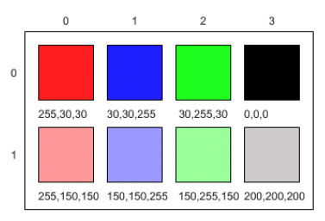
Picture Lab
Colors consist of 3 integer values that range in value from 0 to 255.
Color c = new Color( 255, 30, 30);
red
green
blue

Slide 15
Picture Lab
Colors consist of 3 integer values that range in value from 0 to 255.
int red = (int) (Math.random()*255);
int green = (int) (Math.random()*255);
int blue = (int) (Math.random()*255);
Color c = new Color( red, green, blue);
Notes:
Colors consist of 3 integer values that range in value from 0 to 255.

Slide 16
Picture Lab Code\ pixLab \ classes \ ColorChooser.java

Slide 17
Picture Lab
public static void main( String args[])
{
Picture pix = new Picture("aplus.jpg");
pix.explore();
}

Slide 18
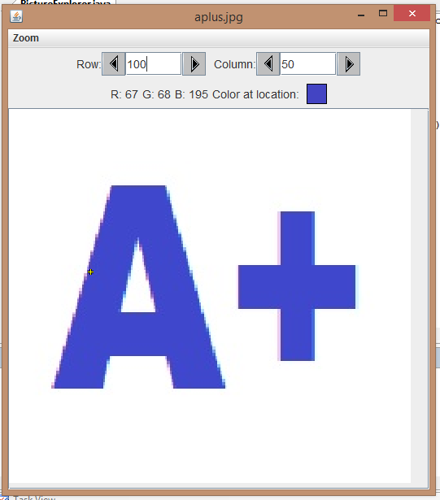
Picture Lab
public static void main( String args[])
{
Picture pix = new Picture("aplus.jpg");
pix.explore();
}

Slide 19
Picture Lab
Picture p = new Picture("aplus.jpg");
Picture smallP = p.scale(0.5,0.5);
smallP.write("halfaplus.jpg");

Slide 20
Picture Lab Code\ pixLab \ classes \ PictureExplorer.java

Slide 21
Pixels and Pictures

Slide 22
What is a Picture?
A picture is a matrix of values that
represent the colors and components
of the image. Each spot in the matrix
is a class that stores several bits of
information.
1 | 2 | 3
4 | 5 | 6
7 | 8 | 9
Notes:
A picture is a matrix of values that represent the colors and components
of the image. Each spot in the matrix is a class that stores several bits of
information.

Slide 23
What is a Picture?
public class Pixel
{
//the digital picture this pixel belongs to
//this ends up as a BufferedImage
private DigitalPicture picture;
//the x (column) location of this
//pixel in the picture; (0,0) is top left */
private int x;
//the y (row) location of this pixel in the picture;
//(0,0) is top left
private int y;
//lots of methods not shown
//toString not shown
}
Notes:
Classes are used to store related methods and variables.

Slide 24
What is a Picture?
In PictureLab, a Picture consists of a matrix of Pixels. Pixel is a class.
Pixel [][] grid;
grid = new Pixel[rows][cols];
In GridWorld, a Grid consisted of a matrix of Actors. Actor[][] grid;
grid = new Actor[rows][cols];
Notes:
In PictureLab, a Picture consists of a matrix of Pixels. Pixel is a class.
Pixel [][] grid;
grid = new Pixel[rows][cols];

Slide 25
What is a Picture?
public static void main(String[] args)
{
Picture aplusPic;
aplusPic = new Picture("aplus.jpg");
aplusPic.explore();
aplusPic.zeroBlue();
aplusPic.explore();
}

Slide 26
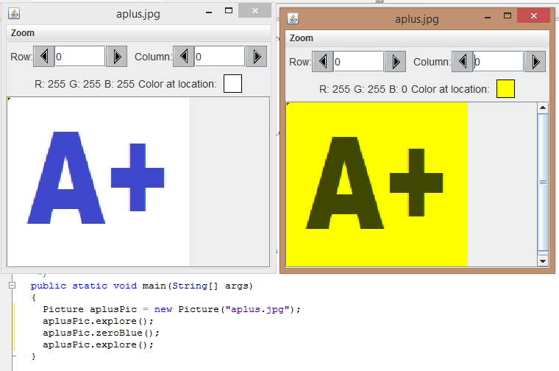
What is a Picture?
After the call to the zeroBlue() method.

Slide 27
Picture Lab Code\ pixLab \ classes \ PictureExplorer.java

Slide 28
Picture Operations

Slide 29
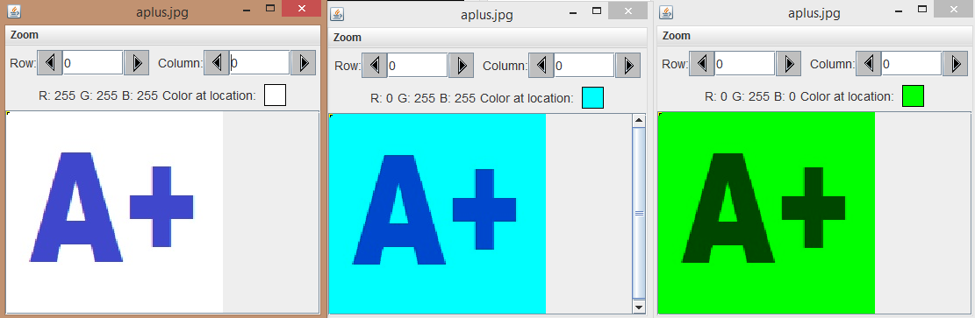
What is a Picture?
public void zeroRed()
{
// what code would you need to
// make a zeroRed( ) method // look at the zeroBlue() method
}
Original no Red no Blue

Slide 30
Picture Lab Code\ pixLab \ classes \ Picture.java

Slide 31
Add in a
ZEROred( ) method

Slide 32
What is a Picture?
Pictures sometimes need to be mirrored. Mirroring sometimes involves copying pixels from one side of the row to the other.
A | P | L | U | S
R | O | C | K | S
G | R | I | D | S
A | P | L | P | A
R | O | C | O | R
G | R | I | R | G

Slide 33
What is a Picture?
Pictures sometimes need to be mirrored. Mirroring sometimes involves copying pixels from one side of the column to the other.
A | P | L | U | S
R | O | C | K | S
G | R | I | D | S
A | P | L | U | S
R | O | C | K | S
A | P | L | U | S

Slide 34
Picture Lab Code\ pixLab \ classes \ Picture.java

Slide 35
Work on Programs!
Crank
Some Code!

